Slide 1
MCDA 5520 Statistics & Business Analytics
Class 1 – Introduction
Michael Zhang

Slide 2
Course Goals
Integrate information technologies with data analytical methods to extract value from data sets.
Think critically about the business implications, meaningfulness and applicability of observed data patterns and analytical inferences.
Identify opportunities, needs and constraints for data analytics within organizational contexts.
Select appropriate analytic tools for specific managerial issues.
Compose data-analytic tools and concepts to create innovative data-analytic solutions.
Demonstrate proficiency with several data-analytic tools.
Communicate clearly and persuasively to audiences with various backgrounds.
Provide leadership in analytics teams and projects.

Slide 3
How to learn / develop skills?
Textbook and cases
Team work
Individual effort
Group work and competitions

Slide 4
Grading Scheme
Team Case Competitions (40 marks)
There will be 7 competitions.
Each time all teams will compete: a 10-15 min presentation of solution to case questions assigned.
First 5 marks, the rest will get 1-4; the ranking matters.
Class Quizzes (20 marks )
6 or 7 quizzes; Individual 50%; Team 50%.
Peer Assessment (10 marks)
Each group member will give you a score from 0 to 10.
A Team Project (30 marks)
Very applied; details to be given.

Slide 5
Analytics
Analytics is the use of: data, information technology, statistical analysis, quantitative methods, and mathematical or computer-based models to help managers gain improved insight about their business operations and make better, fact-based decisions.
Effective Analytics must quickly go beyond conventional dashboard and reporting capabilities and deliver fundamental insights needed to deliver lasting and meaningful outcomes improvement.
Next, let’s discuss some examples.
Notes:
Content Page 2

Slide 6





Pricing & Revenue Management
Background
Optimize pricing strategy to maximize revenue growth
Boost bottom line by 5-10%
Objectives
Development of market segmentation strategy
Derive optimal price and inventory decisions
Notes:
Content Page 2

Slide 7
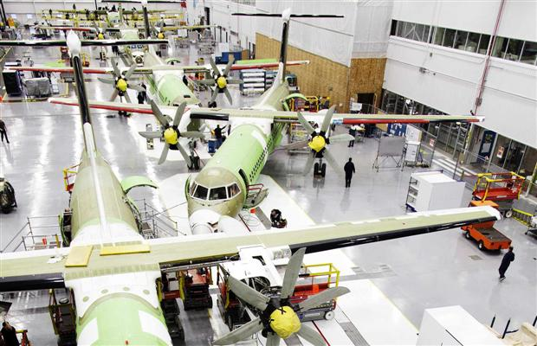

Negotiation & Production
Background
Make-to-order system
Heterogamous customers
Dynamic quotation of price and lead-time (delivery)
Objectives
Effect of negotiation
Optimal quotation
Optimal production control
Notes:
Content Page 2

Slide 8

Resource Management
Background
Nova Scotia’s gold is 99% pure, meaning that it isn’t combined with other minerals when it is found in nature
Gold rush years (1860-1900) : Close to 1 million ounces
Small gold mines, high cost
Notes:
Content Page 2

Slide 9
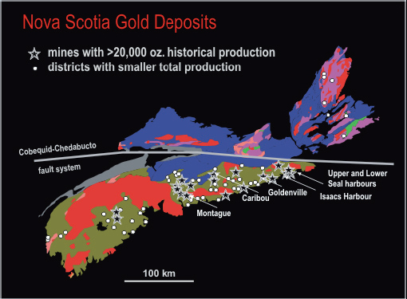
Resource Management
Background
Nova Scotia’s gold is 99% pure, meaning that it isn’t combined with other minerals when it is found in nature
Gold rush years (1860-1900) : Close to 1 million ounces
Small gold mines, high cost
Notes:
Content Page 2

Slide 10
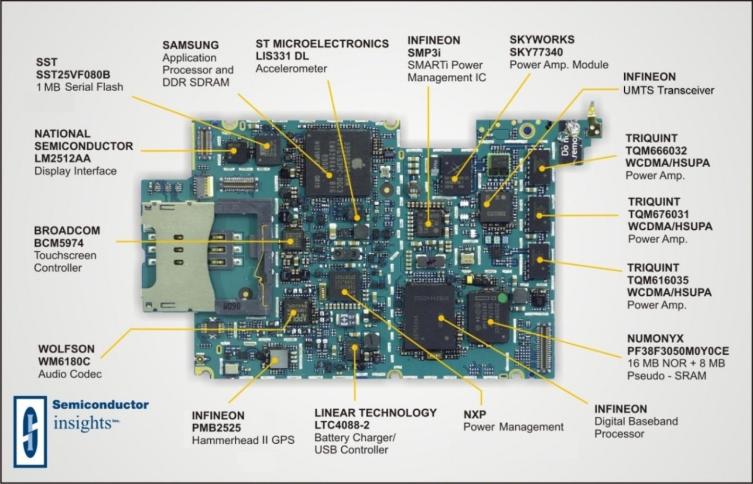





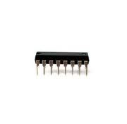
Reducing Electronic Waste
An estimated 100 million tons of electronic waste are produced each year by Environmental Protection Agency

Slide 11
Healthcare Delivery Models
Patients
Care Delivery
Health Status
Setting
Socio- economic Status
Catchment
Area
Access
Location
Provider
Service
Healthy
Rural
High
Local
In Person
Home
Traditional Providers
Wellness
Minor Ailments
Suburban
Medium
Regional
Telephonic
Outpatient Setting
Public/Private Insurers
Risk Assessment
At Risk
Urban
Low
National
Electronic
Hospital
Alternate Providers
Prevention
Acutely Ill
International
Emergency Department
Midlevel Provider
Acute Care
Chronically Ill
Long Term Care
Health Infomediary
Chronic Care
Catastrophic-ally Ill
Internet
Complement-ary Care
Call Center

Slide 12
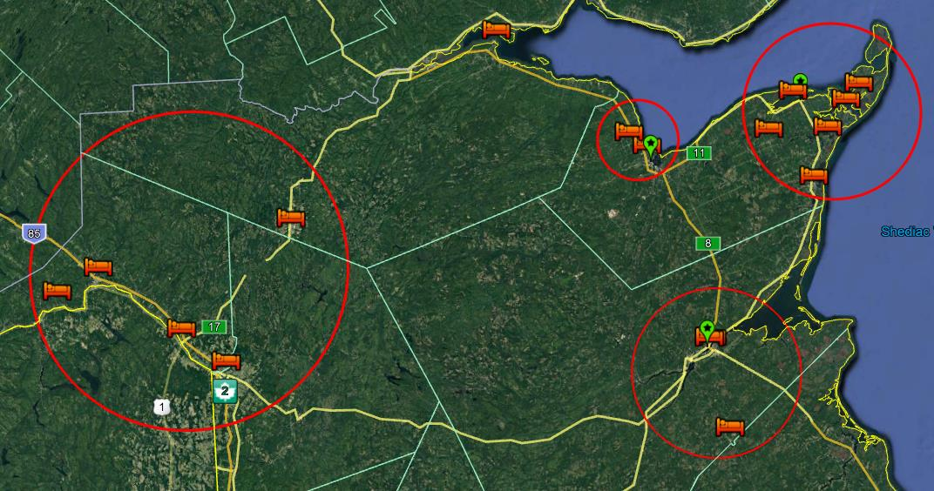
Location Decision: Integrating Logistics, Technology and Service Quality

Slide 13
Forming Teams
Analytical skills (40 points)
Business Background & Knowledge (30 points)
Communication skills (20 points)
Motivation & Interest (10 points)

